Slide 1
The PSYCHODYNAMIC APPROACH

Slide 2
Introduction
Sigmund Freud's psychodynamic approach investigates how unconscious processes influence human behavior.
It emphasizes the functions of the id, ego, and superego in shaping thoughts, feelings, and behaviors.
Unconscious conflicts, wants, and memories all play a significant part in psychological experiences.
Freud suggested that defense mechanisms, such as repression, help our minds cope with difficult thoughts and feelings.
Psychoanalysis is a therapeutic approach that tries to bring unconscious information into conscious awareness in order to promote personal growth.
This technique provides important insights into the intricacies of human behavior and the psyche.
Notes:
Introduction

Slide 3
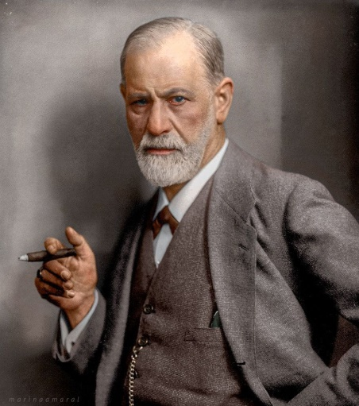
Sigmund Freud
The psychodynamic method arose in the late nineteenth century, coinciding with substantial breakthroughs in psychology.
Sigmund Freud, the founder of psychodynamics, established essential concepts such as the unconscious mind and psychoanalysis in the early twentieth century.
Freud's colleagues, including Carl Jung and Alfred Adler, also helped to shape the psychodynamic approach with their distinct perspectives.
The historical setting of the psychodynamic method represents a period when psychology was transitioning from philosophy and physiology to a distinct field dedicated to studying the human mind.
Influential thinkers such as Freud, Jung, and Adler established psychodynamic theory, which has had a long-lasting impact on the study of psychology.

Slide 4
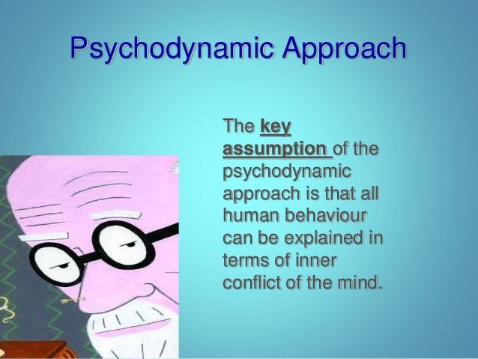
Main Assumptions
The psychodynamic method is based on the premise that unconscious processes have a substantial influence on human behavior.
It holds that an individual's personality and actions are heavily influenced by his or her early childhood experiences.
The id, ego, and superego are essential notions in this approach, each representing a different part of the mind's organization.
Psychodynamics assumes that people use defensive mechanisms to deal with internal conflicts and protect themselves from upsetting thoughts.
The concept believes that studying the unconscious can provide insights into emotional issues as well as opportunities for human growth and self-awareness.

Slide 5
Structure of personality
The psychodynamic method posits a personality structure divided into three parts: the id, ego, and superego.
The "id" symbolizes basic, primal desires that function on the pleasure principle, seeking quick gratification.
The "ego" serves as a rational mediator, balancing the id's urges against the needs of reality.
The "superego" represents societal and moral values, guiding conduct with a sense of good and evil.
According to psychodynamics, the interaction of these three aspects changes a person's thoughts, emotions, and behaviors, offering a framework for understanding personality dynamics.

Slide 6
Contemporary criticisms
Critics of the psychodynamic method now point to its lack of scientific basis and testability.
Critics claim that the technique is not culturally inclusive, potentially ignoring different perspectives on human behavior.
Some argue that Freudian principles are out of date or too deterministic in contemporary psychology.
Psychodynamic treatment techniques, such as psychoanalysis, are criticized for their time-consuming and expensive nature.
Overall, contemporary disputes in psychology center on the importance of scientific validation and the applicability of psychodynamic concepts to varied cultural and individual circumstances.

Slide 7
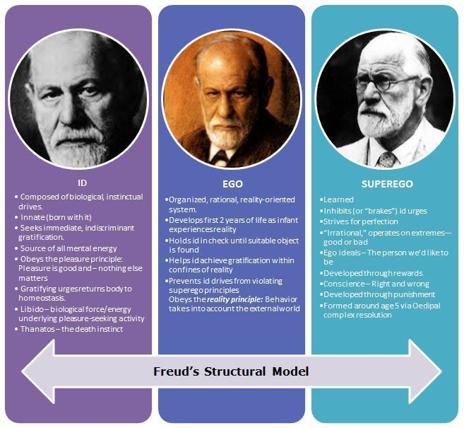
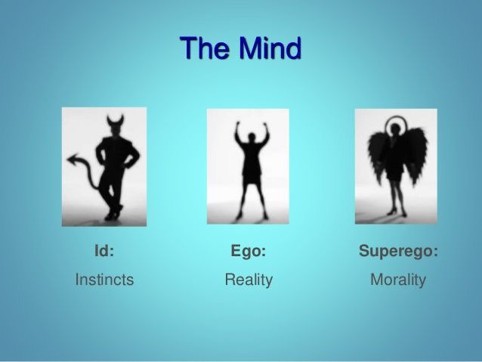

Slide 8
Strengths
The psychodynamic approach stands out for its in-depth investigation of unconscious processes, which provides useful insights into the intricacies of human behavior and motivations. This approach adds to a more nuanced view of personality development and the many processes that shape an individual's psychological landscape by stressing early life experiences and the interaction of the id, ego, and superego.

Slide 9
Weaknesses
While the psychodynamic approach gives useful insights, it has been criticized for a lack of empirical proof and the difficulties in objectively evaluating concepts such as the unconscious mind. Furthermore, the approach has been critiqued for its lack of cultural diversity and the potential for subjective interpretations. Critics claim that its emphasis on early childhood events oversimplifies the complexities of human behavior, and that its therapeutic procedures, such as psychoanalysis, are time-consuming and costly. These shortcomings illustrate the ongoing controversies in the field of psychology.

Slide 10
Reason for Downfall
The psychodynamic approach failed because it relied on subjective interpretations and lacked empirical validation.
Critics contend that its notions, which are based on Freudian beliefs, have struggled to bear scrutiny and do not integrate well with modern scientific procedures.
The approach's intricacy and emphasis on unconscious processes made it difficult to develop quantitative and replicable research, which contributed to its downfall.
Evolving psychological tendencies encouraged more empirically based and culturally inclusive ideas, reducing the importance of the psychodynamic approach.
The decline can also be ascribed to a shift toward shorter-term, goal-oriented therapeutic techniques, which contrast with the protracted and exploratory nature of conventional psychodynamic treatment.

Slide 11
Contemporary Relevance
Despite historical criticism, the psychodynamic approach has present relevance in psychology. Its emphasis on unconscious processes, early life experiences, and the interaction of psychological forces continues to shape therapeutic techniques, particularly in psychodynamic psychotherapy. Some academics claim that notions such as attachment theory and the exploration of the unconscious mind are consistent with modern neuroscientific results, adding to ongoing debates concerning the psychodynamic approach's long-term relevance in understanding human behavior and mental health.

Slide 12
Conclusion
To summarize, the psychodynamic method, with its emphasis on unconscious processes, personality structures, and early life events, has had an everlasting impact on the discipline of psychology. Despite historical criticism, its continued importance is evident in contemporary discussions, particularly in psychodynamic psychotherapy and the study of the unconscious mind. While obstacles exist, the approach continues to impact our knowledge of human behavior and has a significant influence on therapeutic practices and psychological research.
Notes:
POLL

Slide 13
Thank you
Yashika Amaranath
BSCPC0000401
Introduction Psychology
Yashiamaranath@icloud.com

